Slide 1


Dè chì mi sa bhaile,
sa bhaile, sa bhaile?
Dè chì mi sa bhaile,
sa bhaile an-diugh?
Notes:
What can I see in the town,
In the town, in the town?
What can I see in the town?
What can I see today?

Slide 2
Chì mise càraichean,
Càraichean, càraichean.
Chì mise càraichean
A’ falbh an-diugh.
Notes:
I can see cars
cars, cars
I can see cars
Going/leaving today

Slide 3
Dè chì mi sa bhaile,
sa bhaile, sa bhaile?
Dè chì mi sa bhaile,
sa bhaile an-diugh?
Notes:
What can I see in the town,
In the town, in the town?
What can I see in the town?
What can I see today?

Slide 4
Chì mise busaichean,
Busaichean, busaichean.
Chì mise busaichean
Ag obair an-diugh.
Notes:
I can see buses
buses, buses
I can see buses
Working today

Slide 5
Dè chì mi sa bhaile,
sa bhaile, sa bhaile?
Dè chì mi sa bhaile,
sa bhaile an-diugh?
Notes:
What can I see in the town,
In the town, in the town?
What can I see in the town?
What can I see today?

Slide 6

Chì mise bùithtean,
Bùithtean, bùithtean.
Chì mise bùithtean
Fosgailt’ an-diugh.
Notes:
I can see shops
shops, shops
I can see shops
Open today

Slide 7
Dè chì mi sa bhaile,
sa bhaile, sa bhaile?
Dè chì mi sa bhaile,
sa bhaile an-diugh?
Notes:
What can I see in the town,
In the town, in the town?
What can I see in the town?
What can I see today?

Slide 8
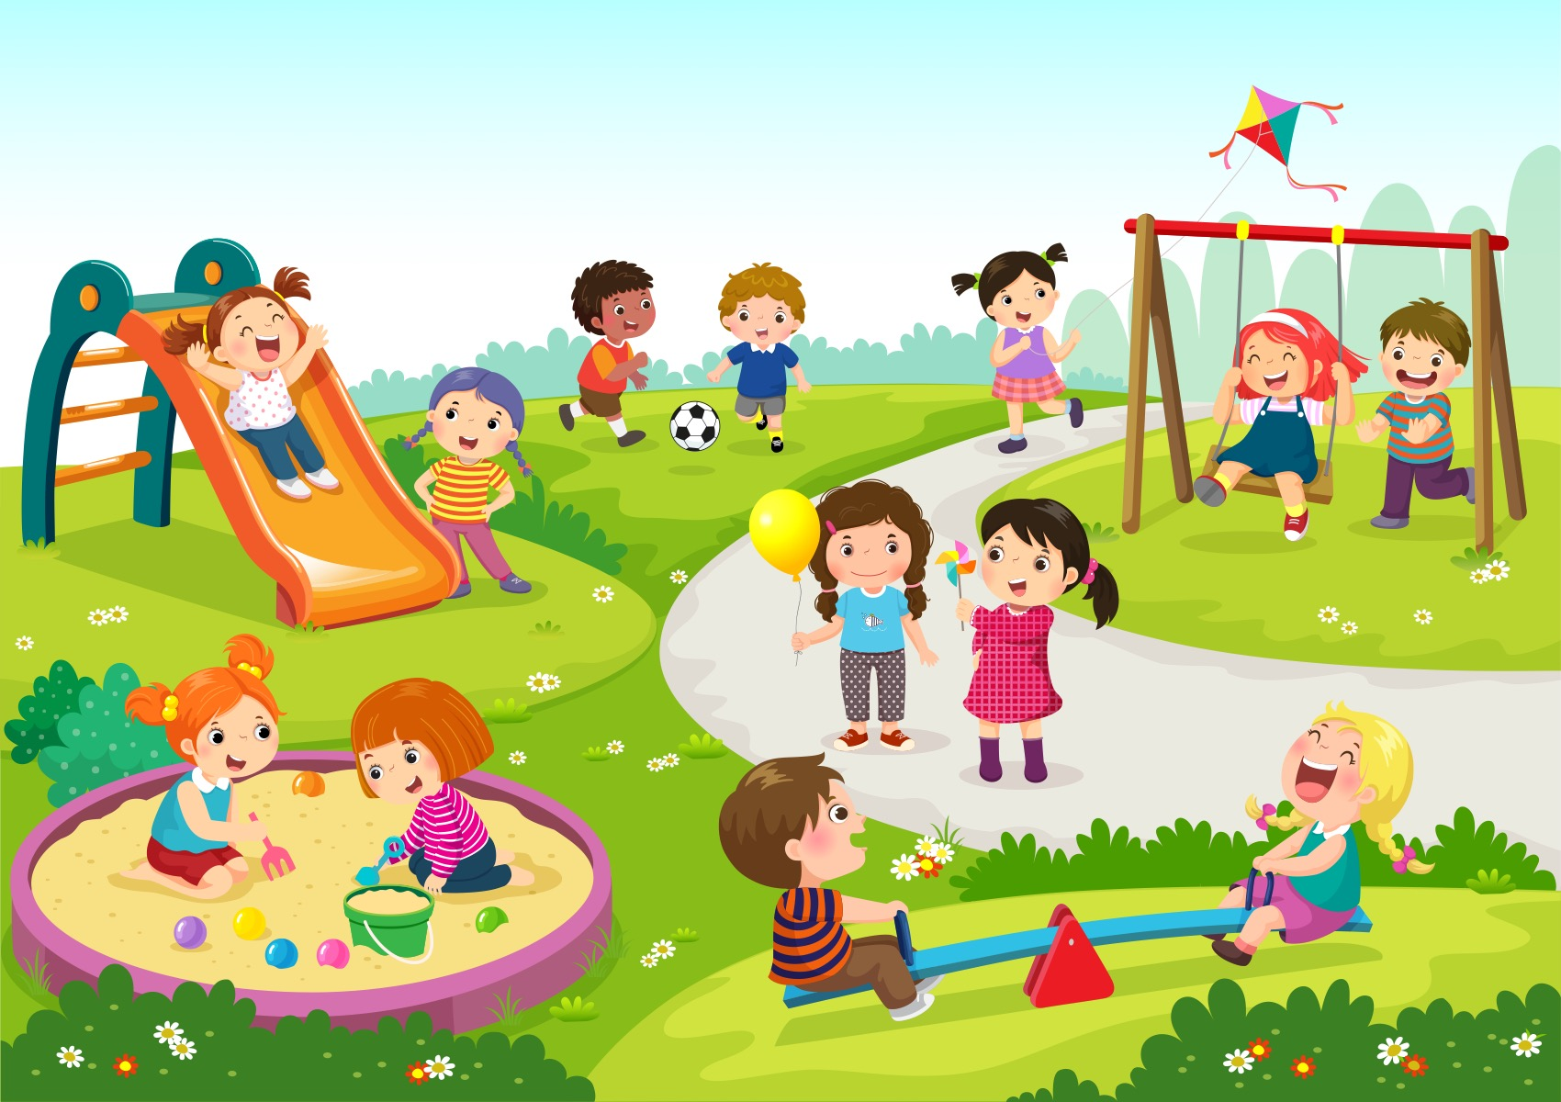
Chì mise pàirc mhòr,
Pàirc mhòr, pàirc mhòr.
Chì mise pàirc mhòr
’Sam bi sinn a’ cluich.
Notes:
I can see a big park,
A big park, a big park.
I can see a big park
In which we play.

Slide 9
Dè chì mi sa bhaile,
sa bhaile, sa bhaile?
Dè chì mi sa bhaile,
sa bhaile an-diugh?
Notes:
What can I see in the town,
In the town, in the town?
What can I see in the town?
What can I see today?

